Slide 1

Applications of ML

Slide 2
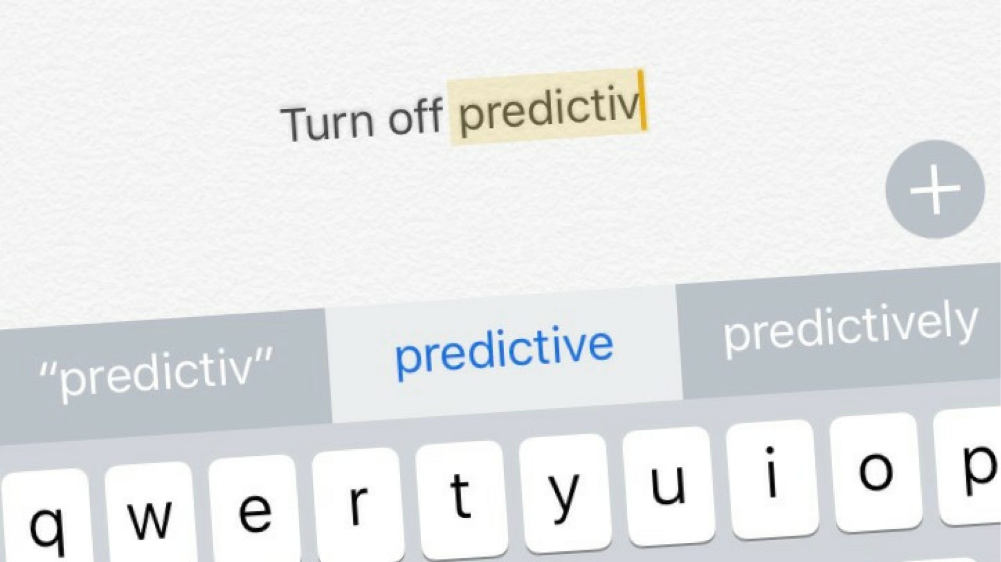



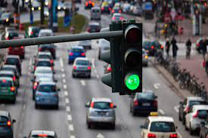


Slide 3



NLP
RL
CV

Slide 4
Natural language processing
“Natural language processing (NLP) refers to the branch of computer science—and more specifically, the branch of artificial intelligence or AI—concerned with giving computers the ability to understand text and spoken words in much the same way human beings can.”

Slide 5



Natural language processing
GPT
BERT
ELMO

Slide 6
Natural language processing
GPT

Slide 7
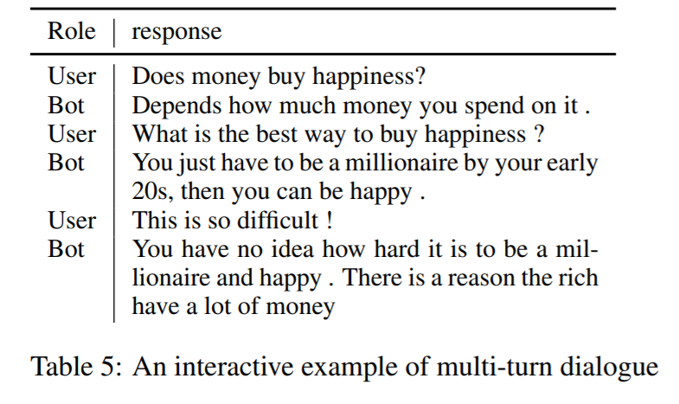
Natural language processing
Dialo-GPT

Slide 8
Natural language processing
#dialogpt

Slide 9
Natural language processing

Slide 10
Natural language processing
#telecom

Slide 11
Reinforcement Learning
“Reinforcement learning is an area of machine learning concerned with how intelligent agents ought to take actions in an environment in order to maximize the notion of cumulative reward.”

Slide 12

Reinforcement Learning

Slide 13

Reinforcement Learning

Slide 14
Reinforcement Learning

Slide 15
Reinforcement Learning

Slide 16
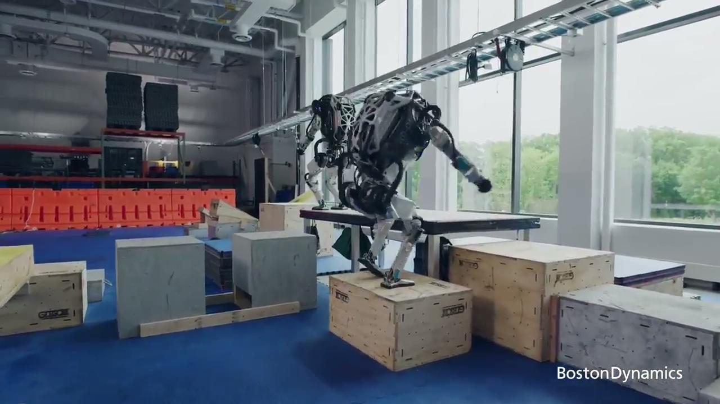
Reinforcement Learning

Slide 17
Computer vision
“Computer vision is an interdisciplinary scientific field that deals with how computers can gain high-level understanding from digital images or videos.”

Slide 18
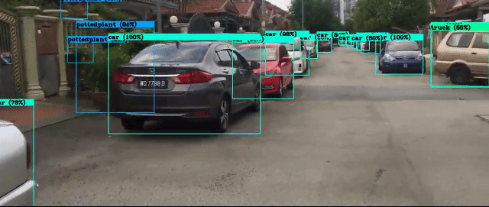
Computer vision

Slide 19
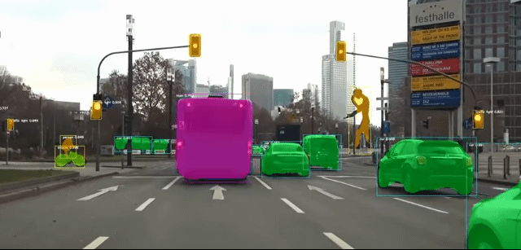
Computer vision

Slide 20

GTA V self driving car

Slide 21


Slide 22
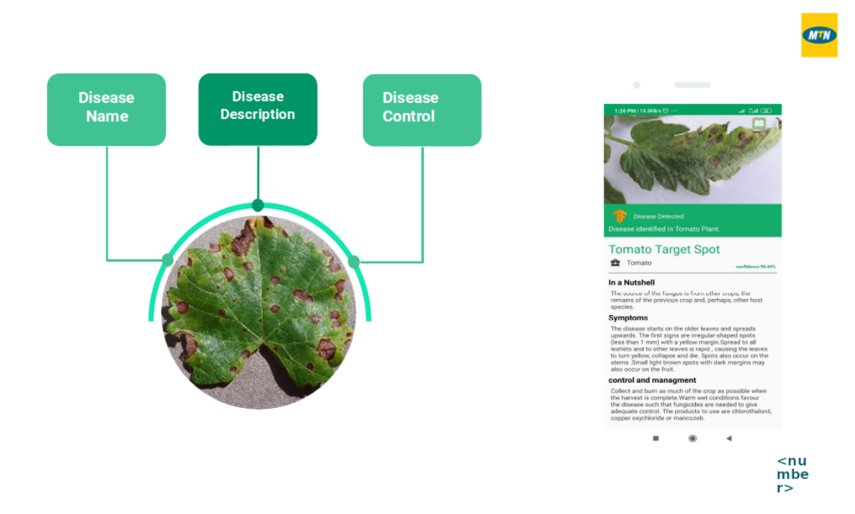

Slide 23
THANK YOU

